Slide 1

United Nations Financial Aid
Clustering of Countries based on socio-economic factors
Dimitris Bakogiannis
Nasos Karathanasopoulos
Vasileios Giannoulas

Slide 2


Who we are
We are a non-profit organisation called DNV dedicated to support people and communities around the world to fight poverty in collaboration with the United Nations and the Sustainable Development Goals Programme other international organizations.
Project Description
Our project focuses on:
Categorise countries based on socio-economic criteria that sums up to the development level of each country
Determine a strategy for countries in urgent need of United Nations financial aid
Data
The dataset includes a comprehensive coverage of 167 countries.
The features that we used for our project are: Child mortality, Country’s imports and exports, Health care index,
National income, Inflation, Life expectancy, Total fertility rate and the GDPP.

Slide 3
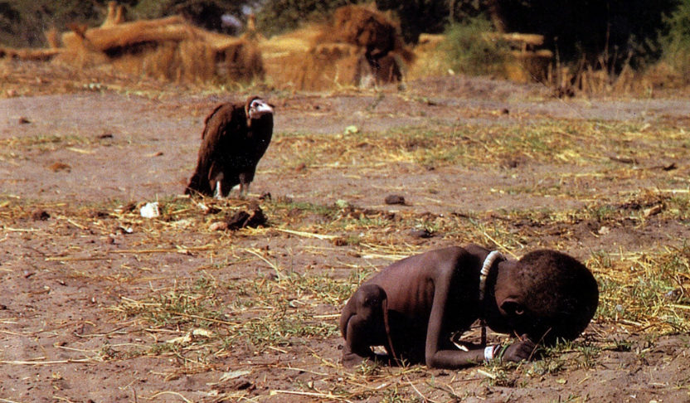
Business Need(What is the problem?)
Sustainable Development Goals:
Goal 1: No Poverty
As of 2015, about 736 million people live on less than US$1.90 a day 🚩⚠️
10% of the world’s population live in the extreme poverty🚩⚠️
1.3 Billion people live in multidimensional poverty🚩⚠️
50% living in poverty under 18%
SDG Targets By 2030:
Reduce by 50% poverty in all dimensions
Implement measure to build resilience for vulnerables societies
Ensure adequate resources for vulnerables societies
Source:https://www.undp.org/sustainable-development-goals/no-poverty

Slide 4
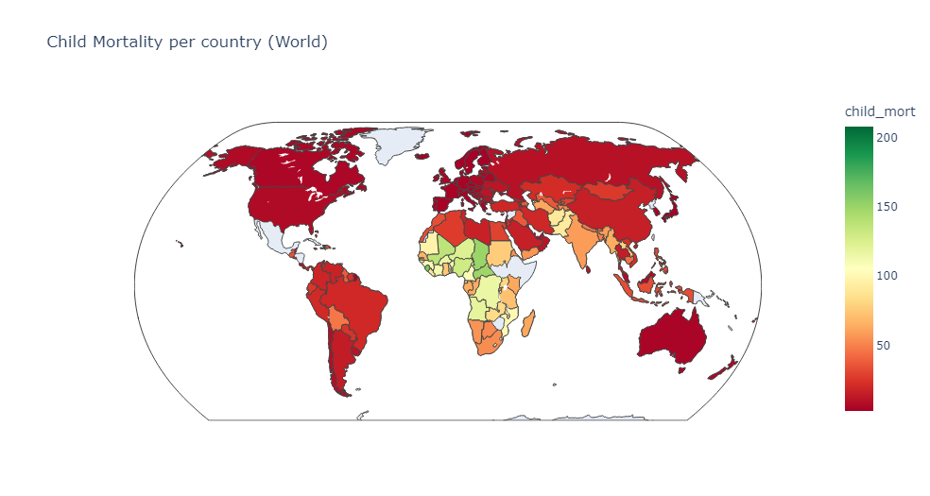
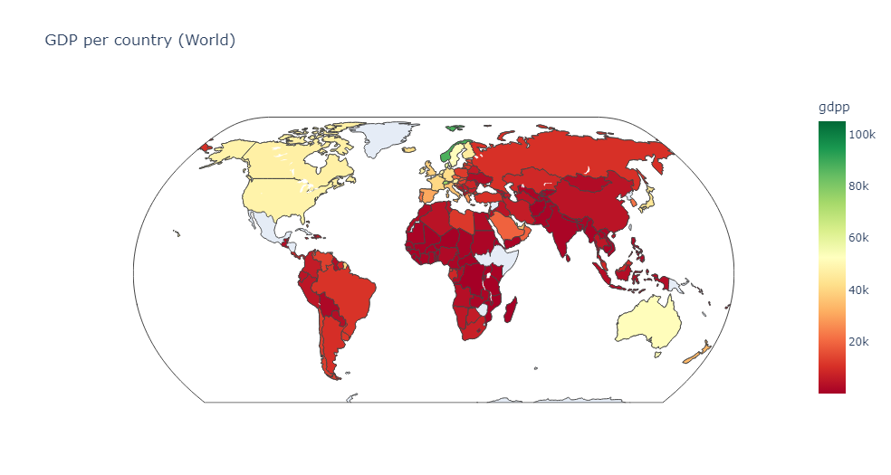
Exploratory Data Analysis
Health Conditions: African Countries lead the way for all the wrong reasons:
Child Mortality, Life Expectancy, GDP
Total Fertilization, Inflation
Nigeria 104% Inflation Rate
While more advanced economies:
United States have the highest spending in health
Qatar,Lux have the highest net income/person

Slide 5
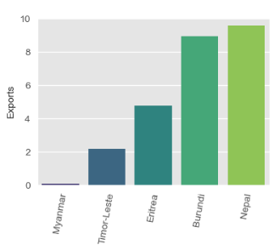
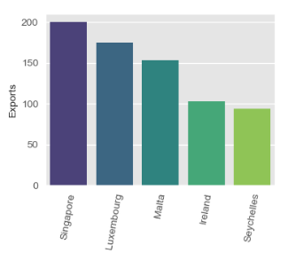
When it comes to trading factor?
Singapore, Luxembourg,Malta are in the top of exports and imports while also their citizens are the highest paid!
Myanmar, Nepal are in the bottom of exports and imports while also their citizens are again in the lowest paid!

Slide 6
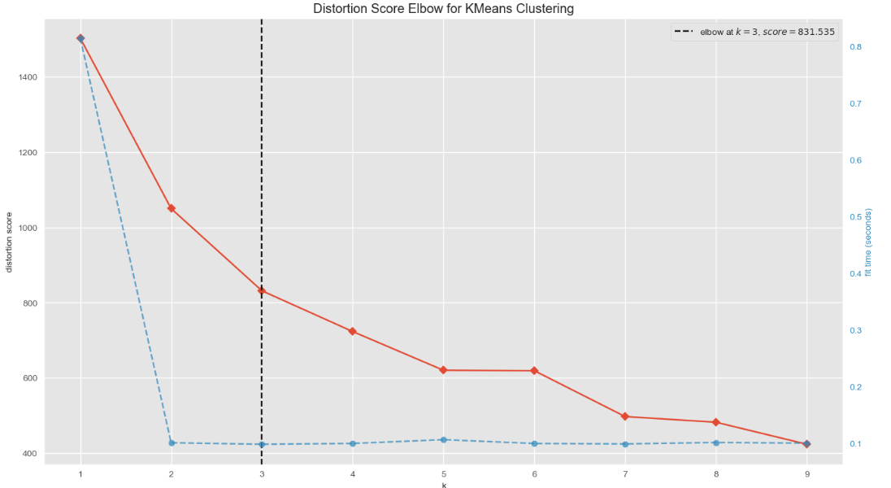
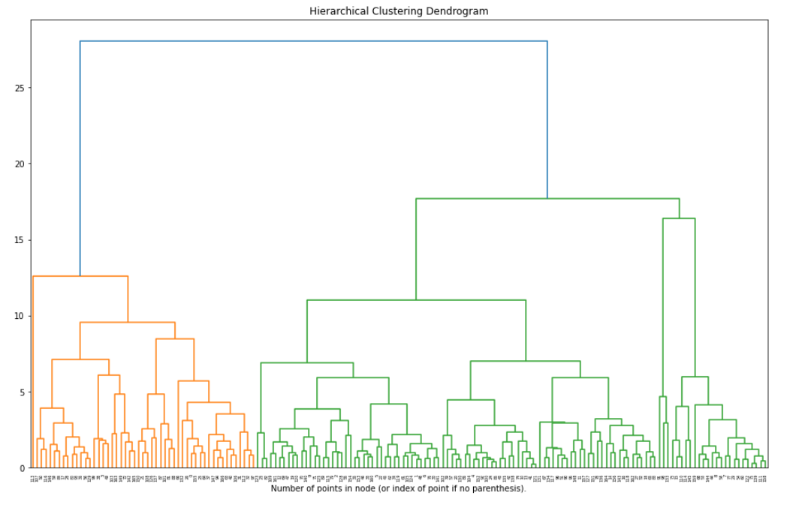
Tuning of Clustering Models (K-Means and Hierarchical)
Conclusions:
Potential best clusters are two or three.
Let’s try both of them!

Slide 7
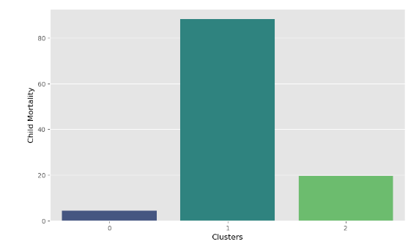
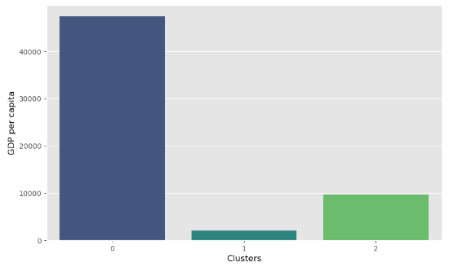
Best Model : Hierarchical model with 3 clusters
The model with 3 clusters managed to separate more clear the countries into three groups:
Developed countries.
Developing countries.
Under-developed countries.

Slide 8
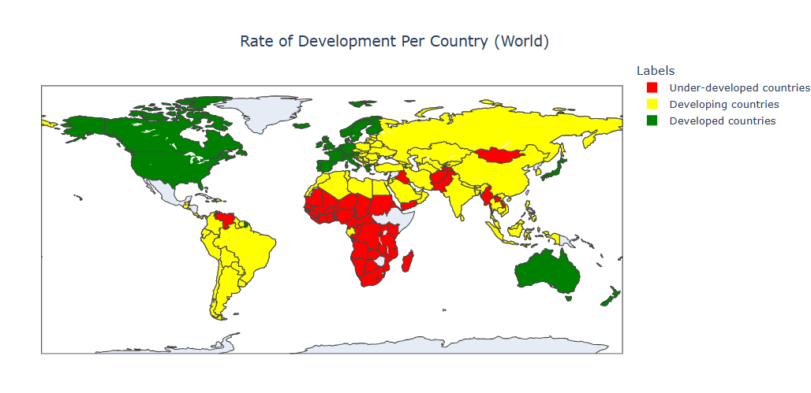
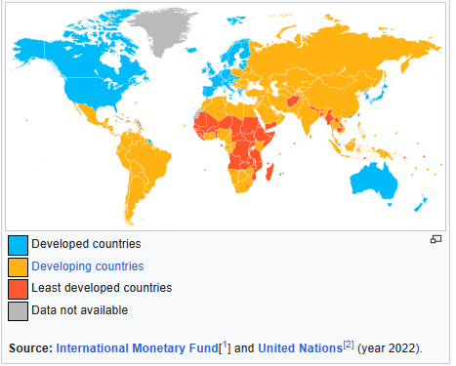
Outcome and Interpretation of Clustering
Rate of Development based on our Model
Rate of Development based on Wikipedia (2022)

Slide 9
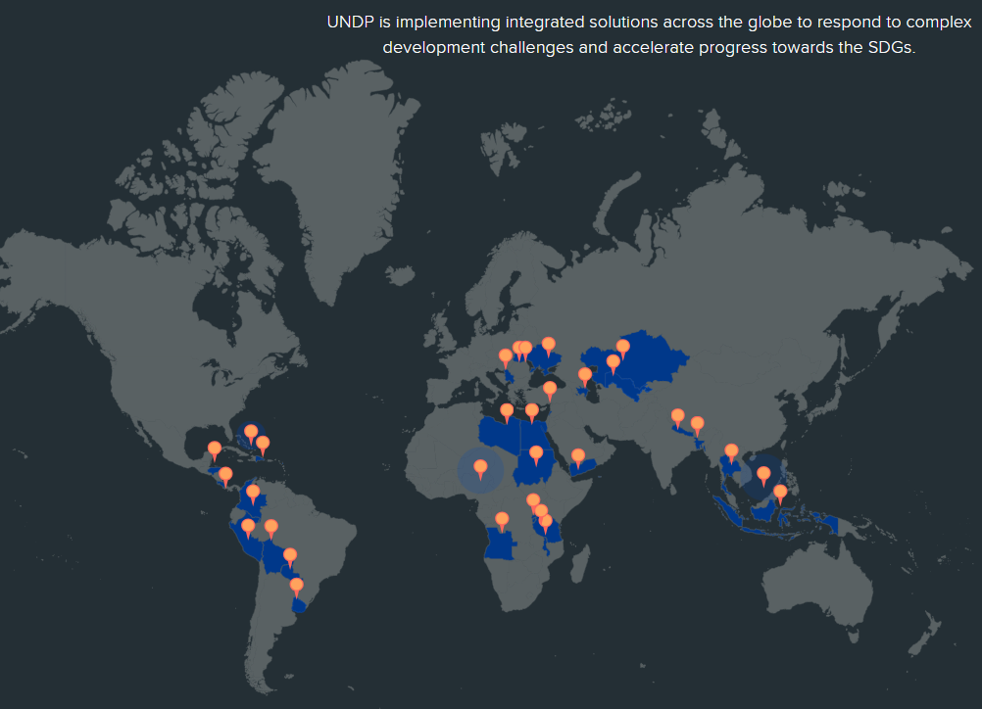
Conclusions
We have observed, through our research/study, that the countries in greatest need of financial support are located in Sub-Saharan Africa as indicated clearly.
Also Syria, Venezuela, Yemen, Pakistan and Afghanistan, Myanmar and Laos are countries outside Africa that need our financial Aid.

Slide 10

Thank you for your time
Any questions?

